Slide 1
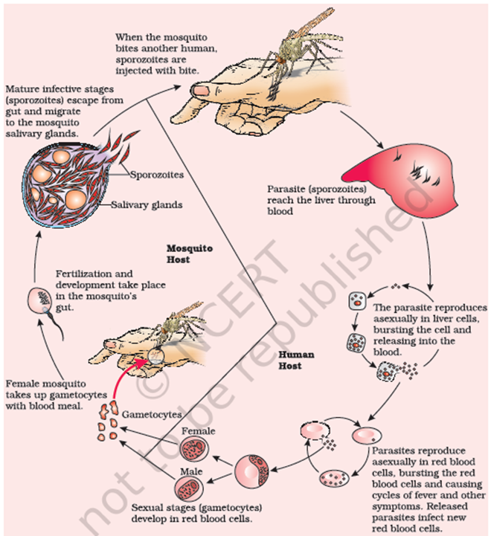
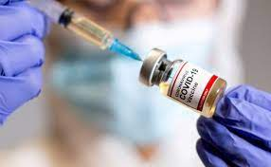
Biology for Engineers Course Code:21BE45
MODULE 2:
Common Diseases and Vaccination - Allergies, Colds and Flu - causes and precautions.
First vaccine in the world, Vaccine for Rabies and RNA vaccines for Covid- critical
analysis, case study of process of development of covid vaccine.
Forensics – DNA fingerprinting. Engineering solutions for Parkinson’s disease. Heart disease and its types.
Modern technologies to detect heart diseases.

Slide 2
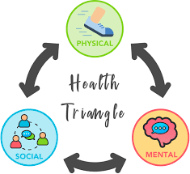
What is Health?
Health is a state of complete physical mental and social well-being. It's not only the absence of disease.​
A person is said to be healthy when he/she is free of any type of disease (infectious/deficiency) when he/she is mentally happy and healthy, and when his/her social relationships are healthy in society.
Hence, to have a healthy life one has to be physically, mentally, and socially complete.

Slide 3
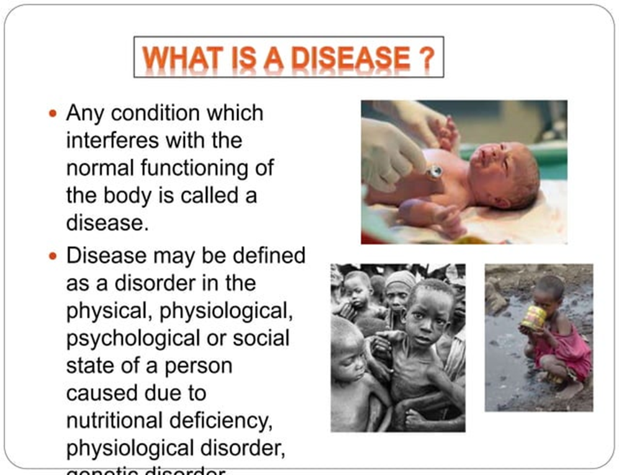

Slide 4
What is difference between infectious and non-infectious diseases?
Diseases can be broadly differentiated into infectious and non-infectious diseases. Diseases that are easily transmitted from one person to another are known as infectious diseases, whereas diseases that remain confined to a person are known as non-infectious diseases.
Non-infectious diseases, including heart disease, stroke, cancer, diabetes and chronic lung disease, are collectively responsible for 74% of all deaths worldwide
What are the types of infectious diseases?
Viral infections. Viruses are a piece of information (DNA or RNA) inside of a protective shell (capsid). ...
Bacterial infections. ...
Fungal infections. ...
Parasitic infections. ...
Transmissible spongiform encephalopathies (TSEs/prion diseases).

Slide 5
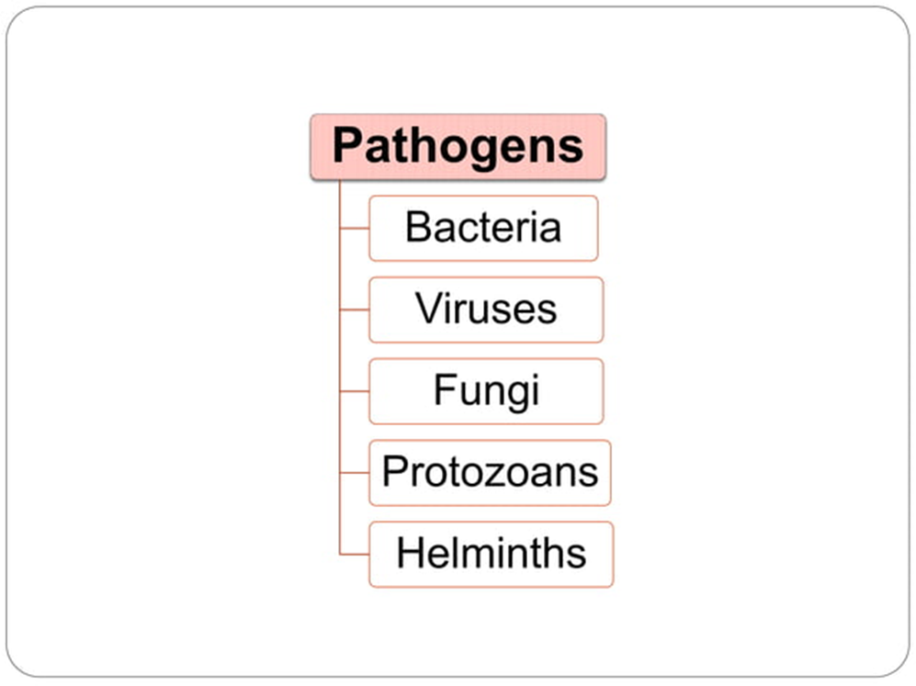

Slide 6
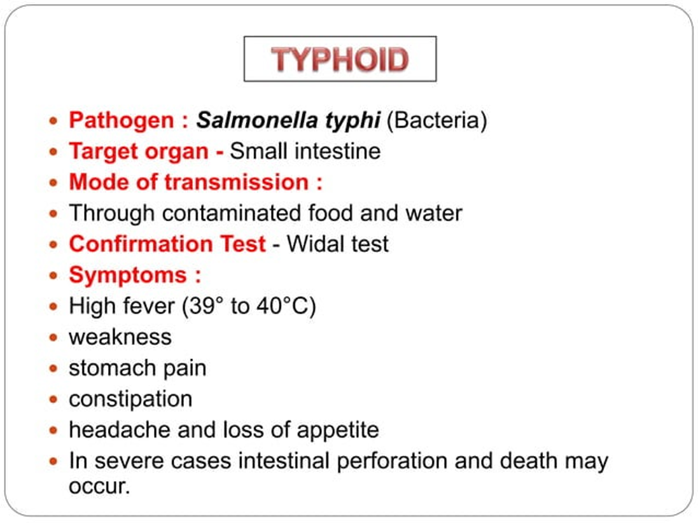

Slide 7
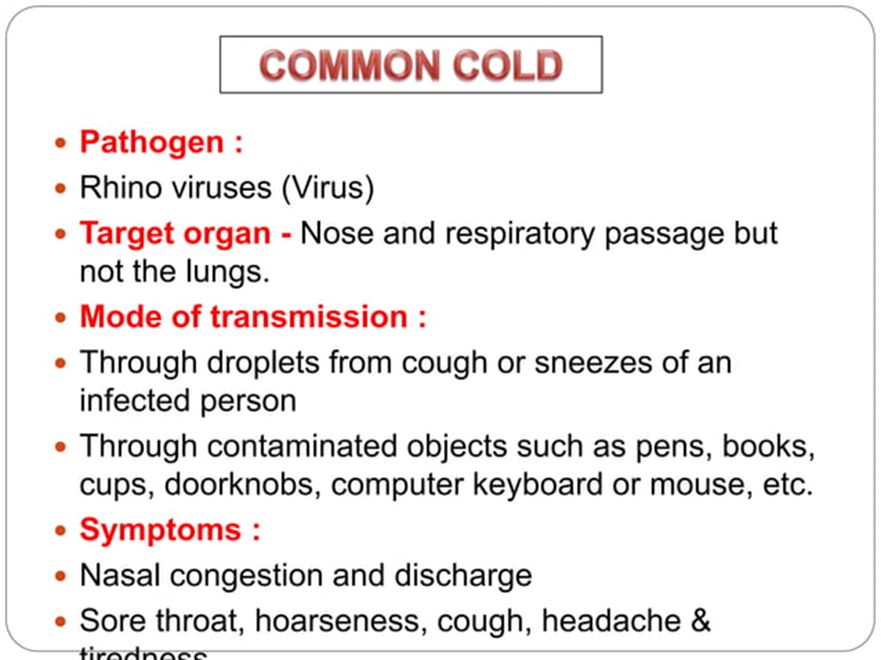

Slide 8
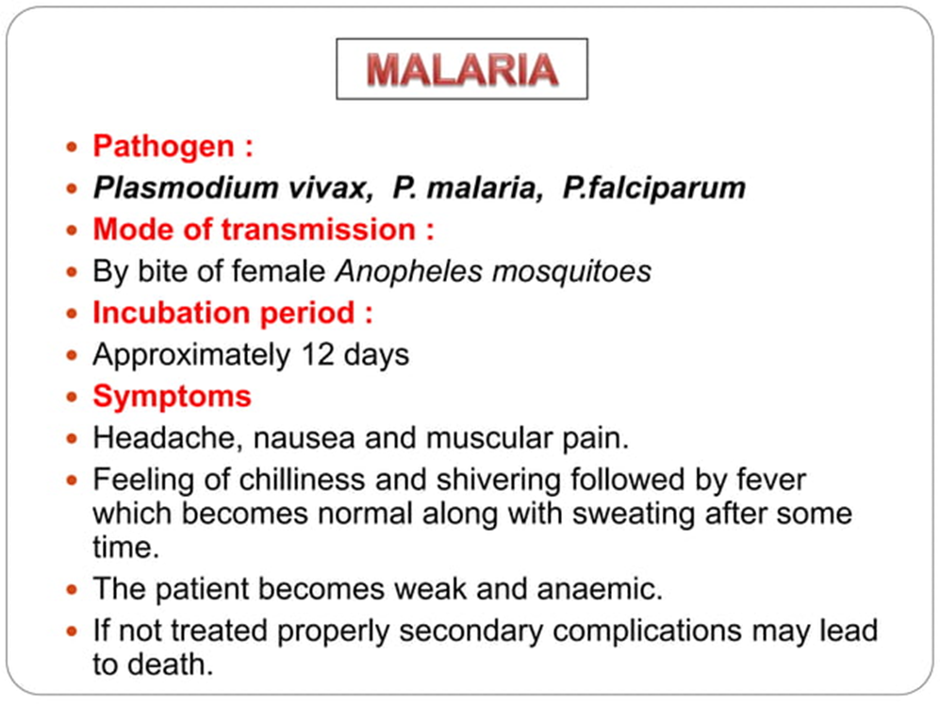
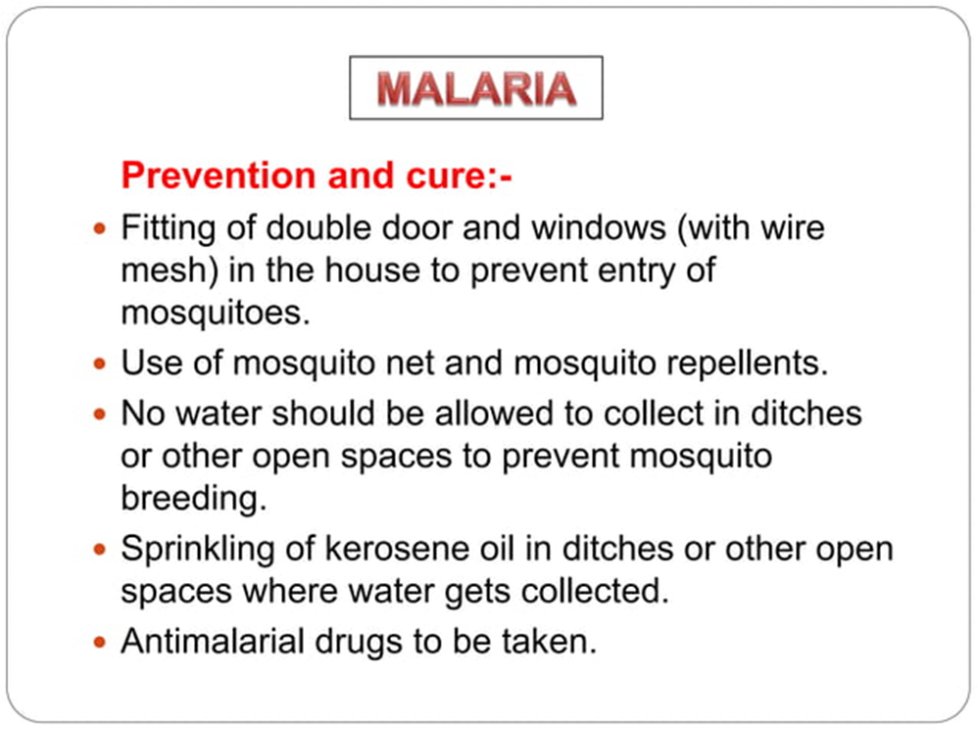

Slide 9
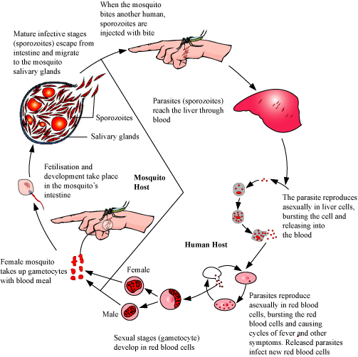

Slide 10
ALLERGIES
What do you mean by allergy?
Allergy occurs when a person reacts to substances in the environment that are harmless to most people. These substances are known as allergens. Allergens are found in dust mites, pets, pollen, insects, ticks, moulds, foods and some medications. What are the 7 allergy symptoms?
Symptoms of an Allergic Reaction
Itchy, watery eyes.
Itchy nose.
Sneezing.
Runny nose.
Rashes.
Hives (a rash with raised red patches)
Stomach cramps.
Vomiting.

Slide 11
Which areas of the body may be affected?
People experience different symptoms, depending on the allergen and where it enters the body. Allergic reactions can involve many parts of the body at the same time.
Nose, eyes, sinuses and throat
When allergens are breathed in, the release of histamine causes the lining of the nose to produce more mucus and become swollen and inflamed. It causes the nose to run and itch, and violent sneezing may occur. Eyes may start to water and people may get a sore throat.
Lungs and chest
Asthma can be triggered during an allergic reaction. When an allergen is breathed in, the lining of the passages in the lungs swells and makes breathing difficult.
Stomach and bowel
Foods that commonly cause allergy include peanuts, seafood, dairy products and eggs. Cow's milk allergy in infants may occur and can cause eczema, asthma, colic and stomach upset. Some people cannot digest lactose (milk sugar). Lactose intolerance causes stomach upsets, but should not be confused with allergy.
Skin
Skin problems that can be triggered by allergy include atopic dermatitis (eczema) and urticaria (hives).

Slide 12
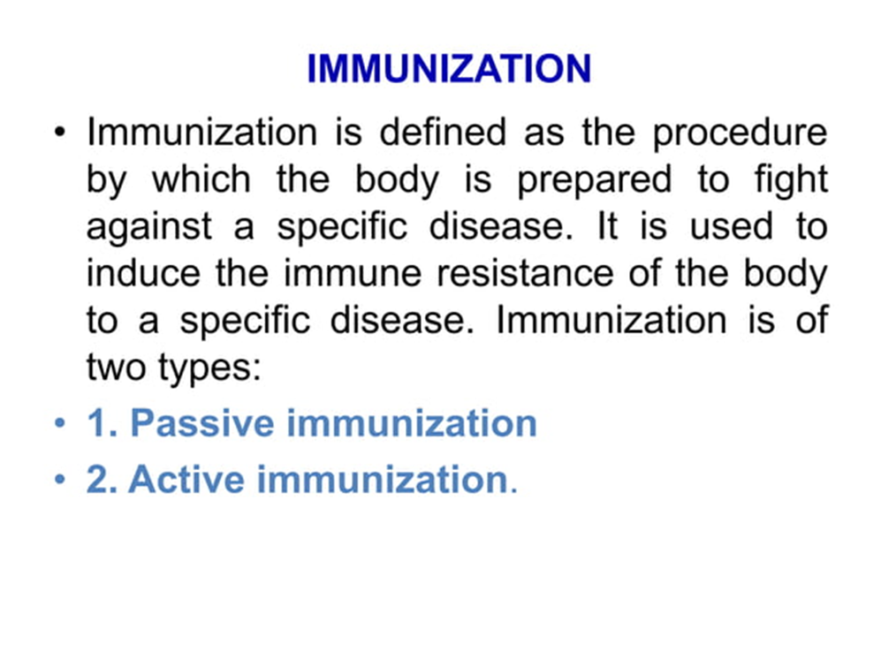

Slide 13
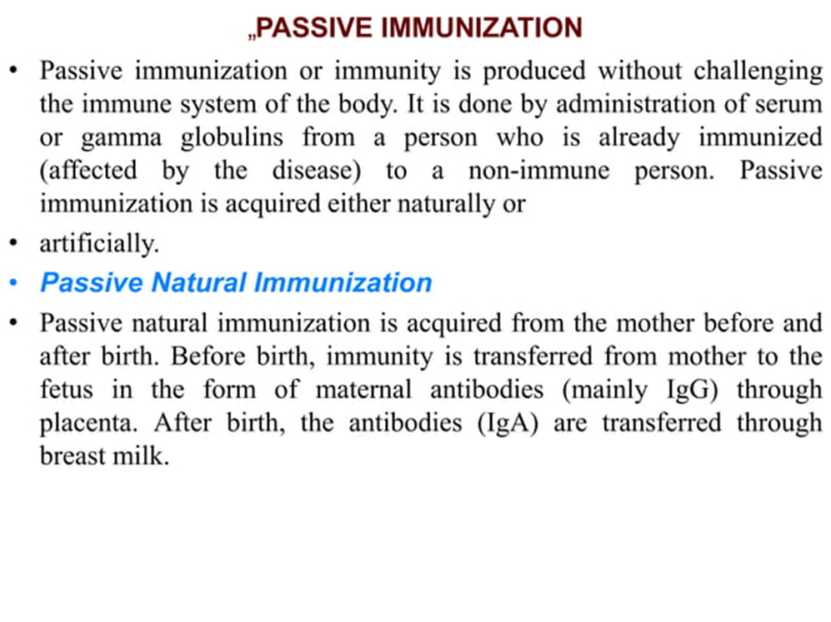

Slide 14
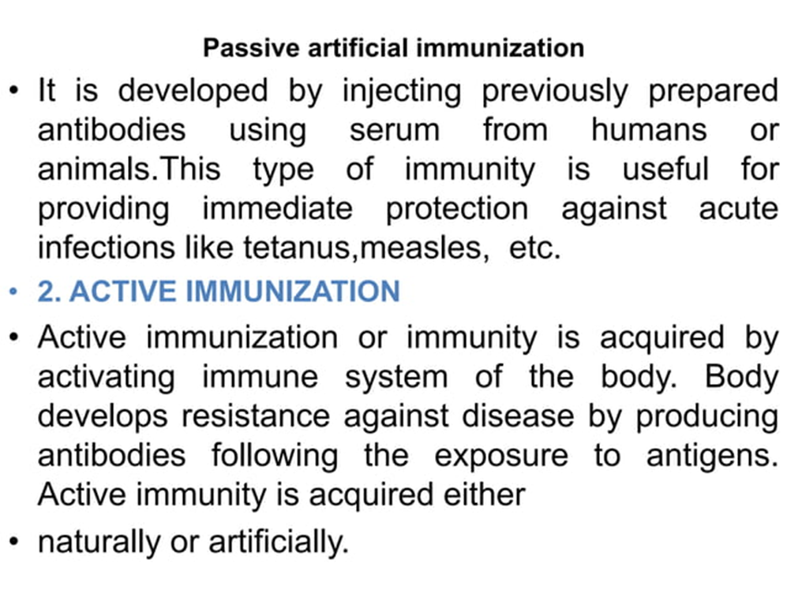

Slide 15
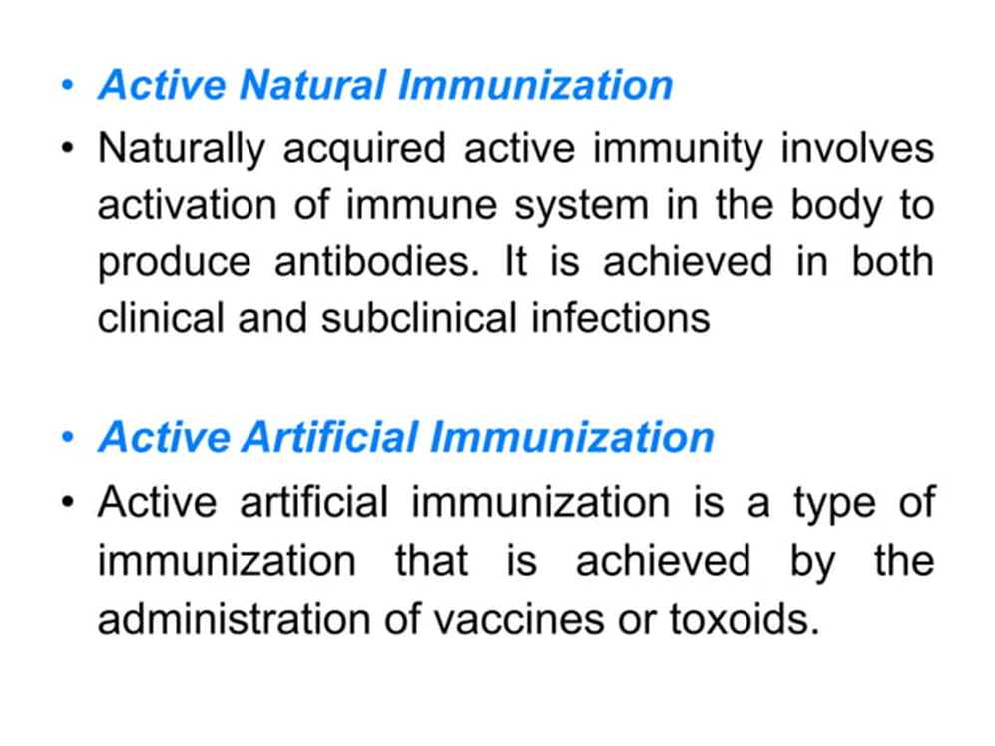

Slide 16
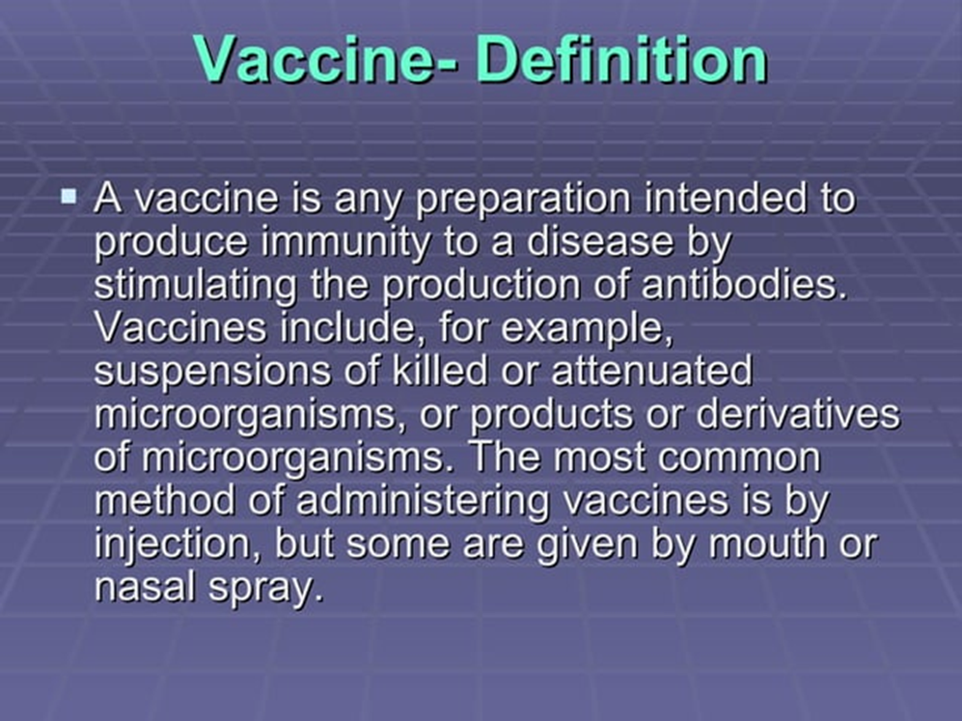

Slide 17
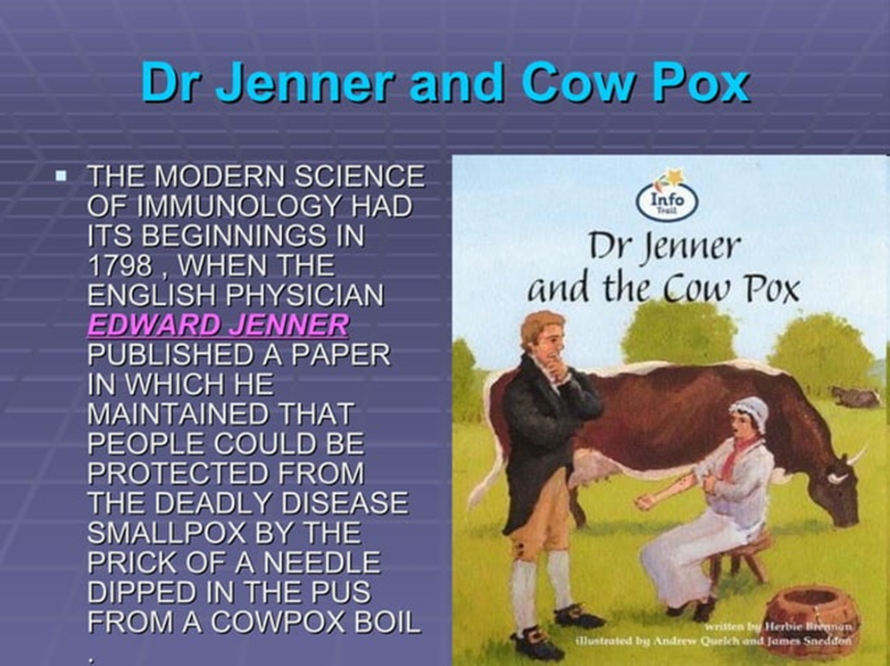
First vaccine in the world The basis for vaccination began in 1796 when the English doctor Edward Jenner noticed that milkmaids who had gotten cowpox were protected from smallpox. Jenner also knew about variolation and guessed that exposure to cowpox could be used to protect against smallpox The smallpox vaccine, introduced by Edward Jenner in 1796, was the first successful vaccine to be developed.

Slide 18
what are the 5 types of vaccines?
Inactivated vaccines.
Live-attenuated vaccines.
Messenger RNA (mRNA) vaccines.
Subunit, recombinant, polysaccharide, and conjugate vaccines.
Toxoid vaccines.
Viral vector vaccines.

Slide 19
Vaccination for Rabies
On July 6, 1885, Louis Pasteur and his colleagues injected the first of 14 daily doses of rabbit spinal cord suspensions containing progressively inactivated rabies virus into 9-year-old Joseph Meister, who had been severely bitten by a rabid dog 2 days before.
The method involved developing a consistent source of virulent virus by taking pieces of spinal cord from a rabid street dog and inoculating by trepanation under the dura mater (dura) into the cranium of a rabbit, and then passing it from rabbit to rabbit 20–25 times until the virus was consistently virulent. When Pasteur had established a way to obtain rabbits with spinal cord material that was consistently virulent, he took pieces of the spinal cord, each a few centimeters long, and exposed them to dry air. The exposure to dry air, gradually decreased the virulence until it totally disappeared.
Pasteur had inoculated approximately 50 dogs with a suspension of the dehydrated spinal cord and he had observed that the dogs had become refractory to the inoculation with virulent rabid spinal material, when on Monday, July 6, 1885, three people arrived from Alsace. One of them was Joseph Meister, a nine-year-old boy who had been bitten by a dog at 8:00 AM on July 4. The boy had at least 14 bites and his death from rabies seemed inevitable.
Using the experience he had already with the 50 dogs, on the evening of July 6, together with Dr. Vulpian and Dr. Grancher ,Pasteur inoculated the boy with material from a rabid rabbit spinal cord that had been dehydrated for 15 days. Pasteur concluded that the boy had survived the rabies from the bites of a rabid dog.

